Slide 1

News Curator
Software Engineering Project
Submitted to:
Mr. Santosh Ray
Submitted by:
Rishabh Chawla 2K18/IT/096
Prince Kirar 2K18/IT/086

Slide 2
Index
Introduction
Requirements
Proposed Design
Data Flow Diagram
Project Architecture
Implementation Overview
Fake News Classifier
Views

Slide 3

Introduction
Fake news is any form of false story or content spread on the internet to influence people’s view to gain inimical benefits. Detecting fake news in the digital world is a significant challenge in overcoming the widespread dissemination of rumors and biases. for eg. there was an article spreading the news that "Cadbury chocolate is infected with HIV-Positive Blood". Rumors began to spread, damaging Cadbury’s reputation

Slide 4
Requirements
Ability to search news articles
Give summary of the news content
Detect whether news is genuine or not
Give detailed sentiment analysis of each news article
Functional web application
Front end deployment for easy access
Give access to top keywords to help users
As requirements were stable and unambiguous, web technology is well understood by us. Waterfall model was decided for development task.

Slide 5
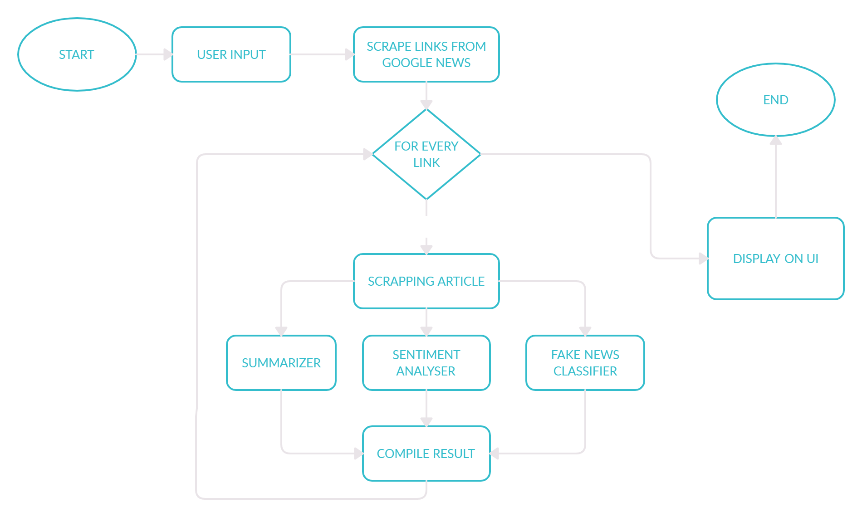
Proposed Design
Scrape links of given input through google news.
For every link, scrape the article and perform sentiment analysis, extract summary classify as fake or not and store each result in compile result.
Once performing analysis on each link display compile result on UI.

Slide 6
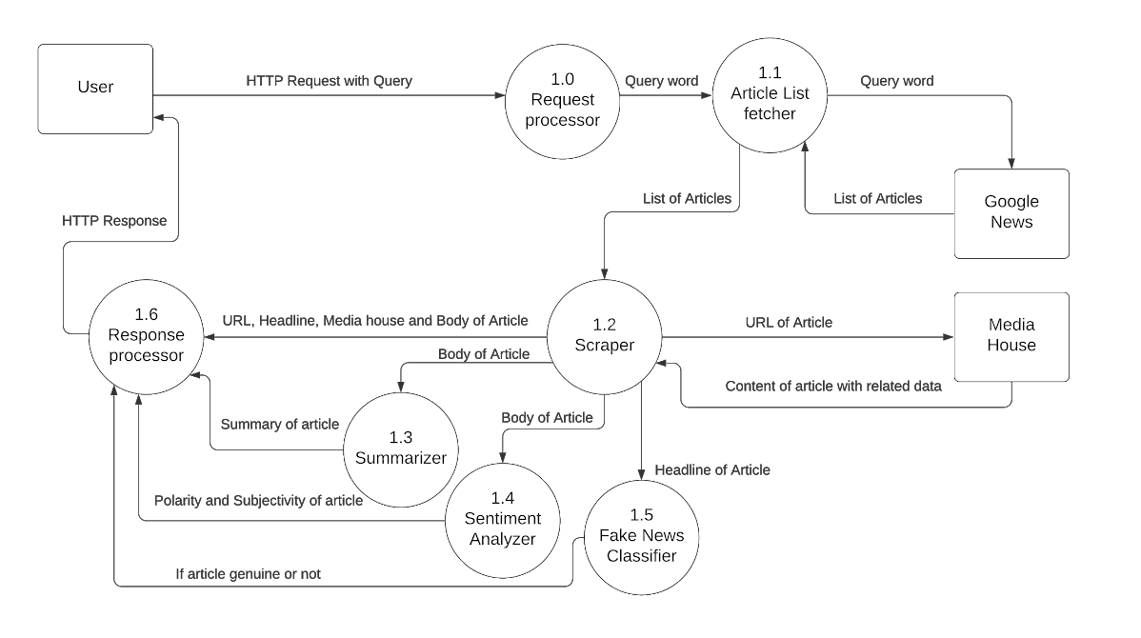
Data Flow Diagram

Slide 7
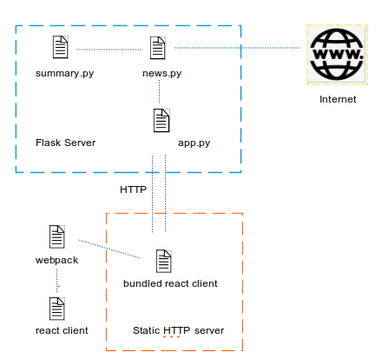
Project Architecture
summary.py : It contains logic for summarizing the content extracted from the news article. It uses the nltk library to process the content.
news.py : It contains logic for extracting news links from google search’s news results, then extracting news content from every news article and then process it using textblob and summary.py.
app.py : It contains code for our flask based http server which connects our logic in news.py with our client using http requests.

Slide 8
Project Architecture
Static HTTP server : http server which renders the bundled react application which consists of static assets. Deployed at :- https://news-curator.vercel.app/
Webpack : webpack is the bundler used to bundle the react project. For processing each file type, regex is used to identify which file loader to use.
React Client : It consists of code for the UI of the web client which will be rendered to the user upon request to our static http server.

Slide 9

Implementation Overview
This project built using:
Scraping tools to accumulate news source and data for article content and metadata using web scraping through google news which uses regular expression for this purpose.
Natural language processing (NLP) to provide sentiment analysis of news .
Machine learning Algorithm to classify news article as fake or genuine.

Slide 10




Tech Stack
Python
Scikit-learn
JavaScript
React.js
Flask
Vercel

Slide 11
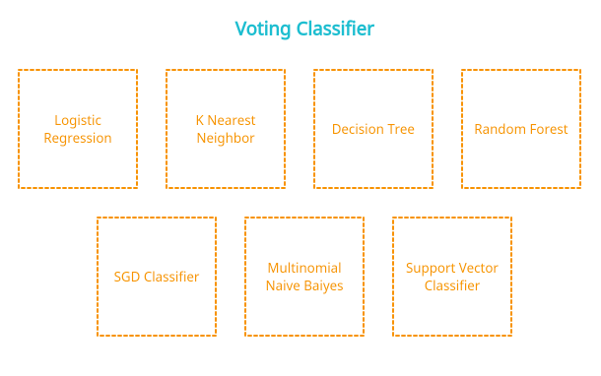
Fake News Classifier
The fake news classifier used is an ensemble learning based model
We used a Max Voting Classifier which gives out result with best accuracy among results from child classifiers

Slide 12
Fake News Classifier
Child classifiers includes:
Logistic regression
KNN
Decision Tree
Random Forest
Stochastic Gradient Descent Classifier
Multinomial Naive Bayes
Support Vector Classifier

Slide 13
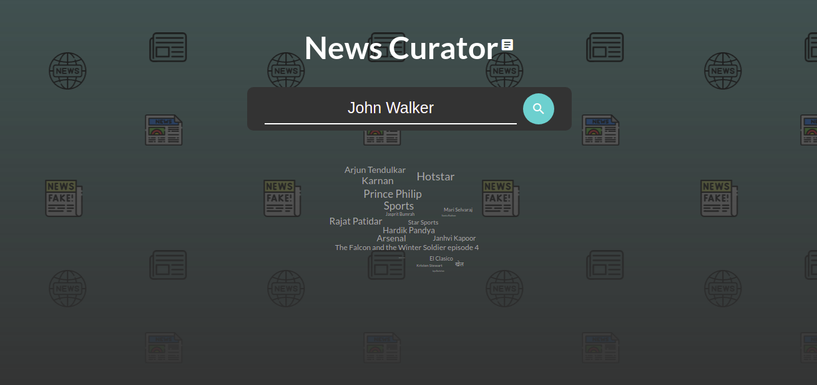
Front Page

Slide 14
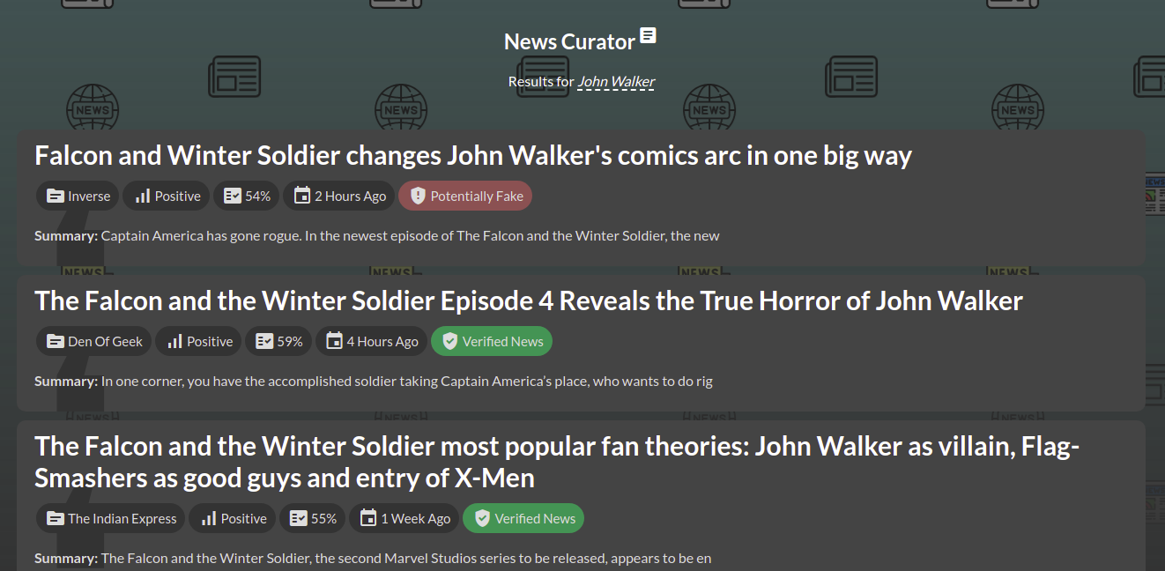
Results View

Slide 15
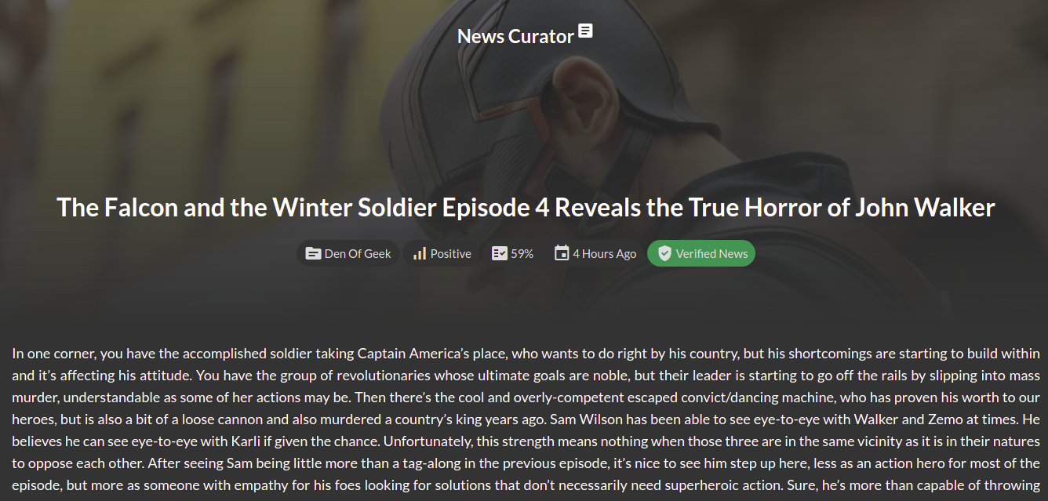
Article View

Slide 16
Thank you!

